Slide 1
Ecommerce Application Design
Prasad Bhalerao

Slide 2
Functional Requirements
Search Box
Featured Products
Related product
Newsletter Subscription
Product Zoom
Categories
Good Navigation
Good Payment Gateway
Privacy Policy
Good Return Policy
Customer login & registration
Good Graphics
Delivery Information
News & Events
Social Media Presence
Administrator Page
New Products Page
Sale Page
Stocks Page
Apply filter & Sorting
Add to cart
Order Confirmation
Out of Stock Admin Page
Add/ Delete Product Page
Inventory Page
Add Promotion Page
Cart Page
Compare products
Wishlist page
Category Page
Product Page
Review Page
Contact Us Page
Testimonials Section
Replacement Page

Slide 3
Non-Functional Requirements
Search API should return results under 2 seconds.
Application should be able to store high quality images.
Application should support Accessibility.
Payment gateway should be secure and industry standard.
Application should encrypt and store customer sensitive information like card details.
Application should support third party login capability.
Application should quickly send Emails to the user within a minute of placing the order.
The system must automatically log out all customers after a period of inactivity.
The system should not leave any cookies on the customer’s computer containing the user’s password.
The system’s back-end servers shall only be accessible to authenticated administrators.
Sensitive data will be encrypted before being sent over insecure connections like the internet.
Secure Socket Layer (SSL)
DB backups and redundant system with automatic switchover.
When system is down/ update in progress/ hardware failure/ DB corruption, a replacement page will be shown.

Slide 4
Assumptions
There can be around 1 Lakh products. User can search on Product Name and Description.
Application serves users in multiple regions in a single country.
Related products can be calculated based on product keywords OR user input based on category.
Traffic flow on the site will be around ~100 users per minute.
Database backups are taken in 30 mins intervals.

Slide 5
Services, NFR & DB Type Mapping
Services | NFR Type | DB Type
Catalog | Scalability, High performance, Low response time | NoSQL, Redis Cache
Basket | Accuracy, Data integrity, Security | SQL
Notification | Interoperatibility, Compliance | SQL
Payment | Interoperatibility, Security, Data integrity | SQL
Order | Accuracy, Data integrity | SQL
Identity Service | Compliance, Security | SQL
Presentation/ UI | Security, Portability, Accessibility | NA

Slide 6
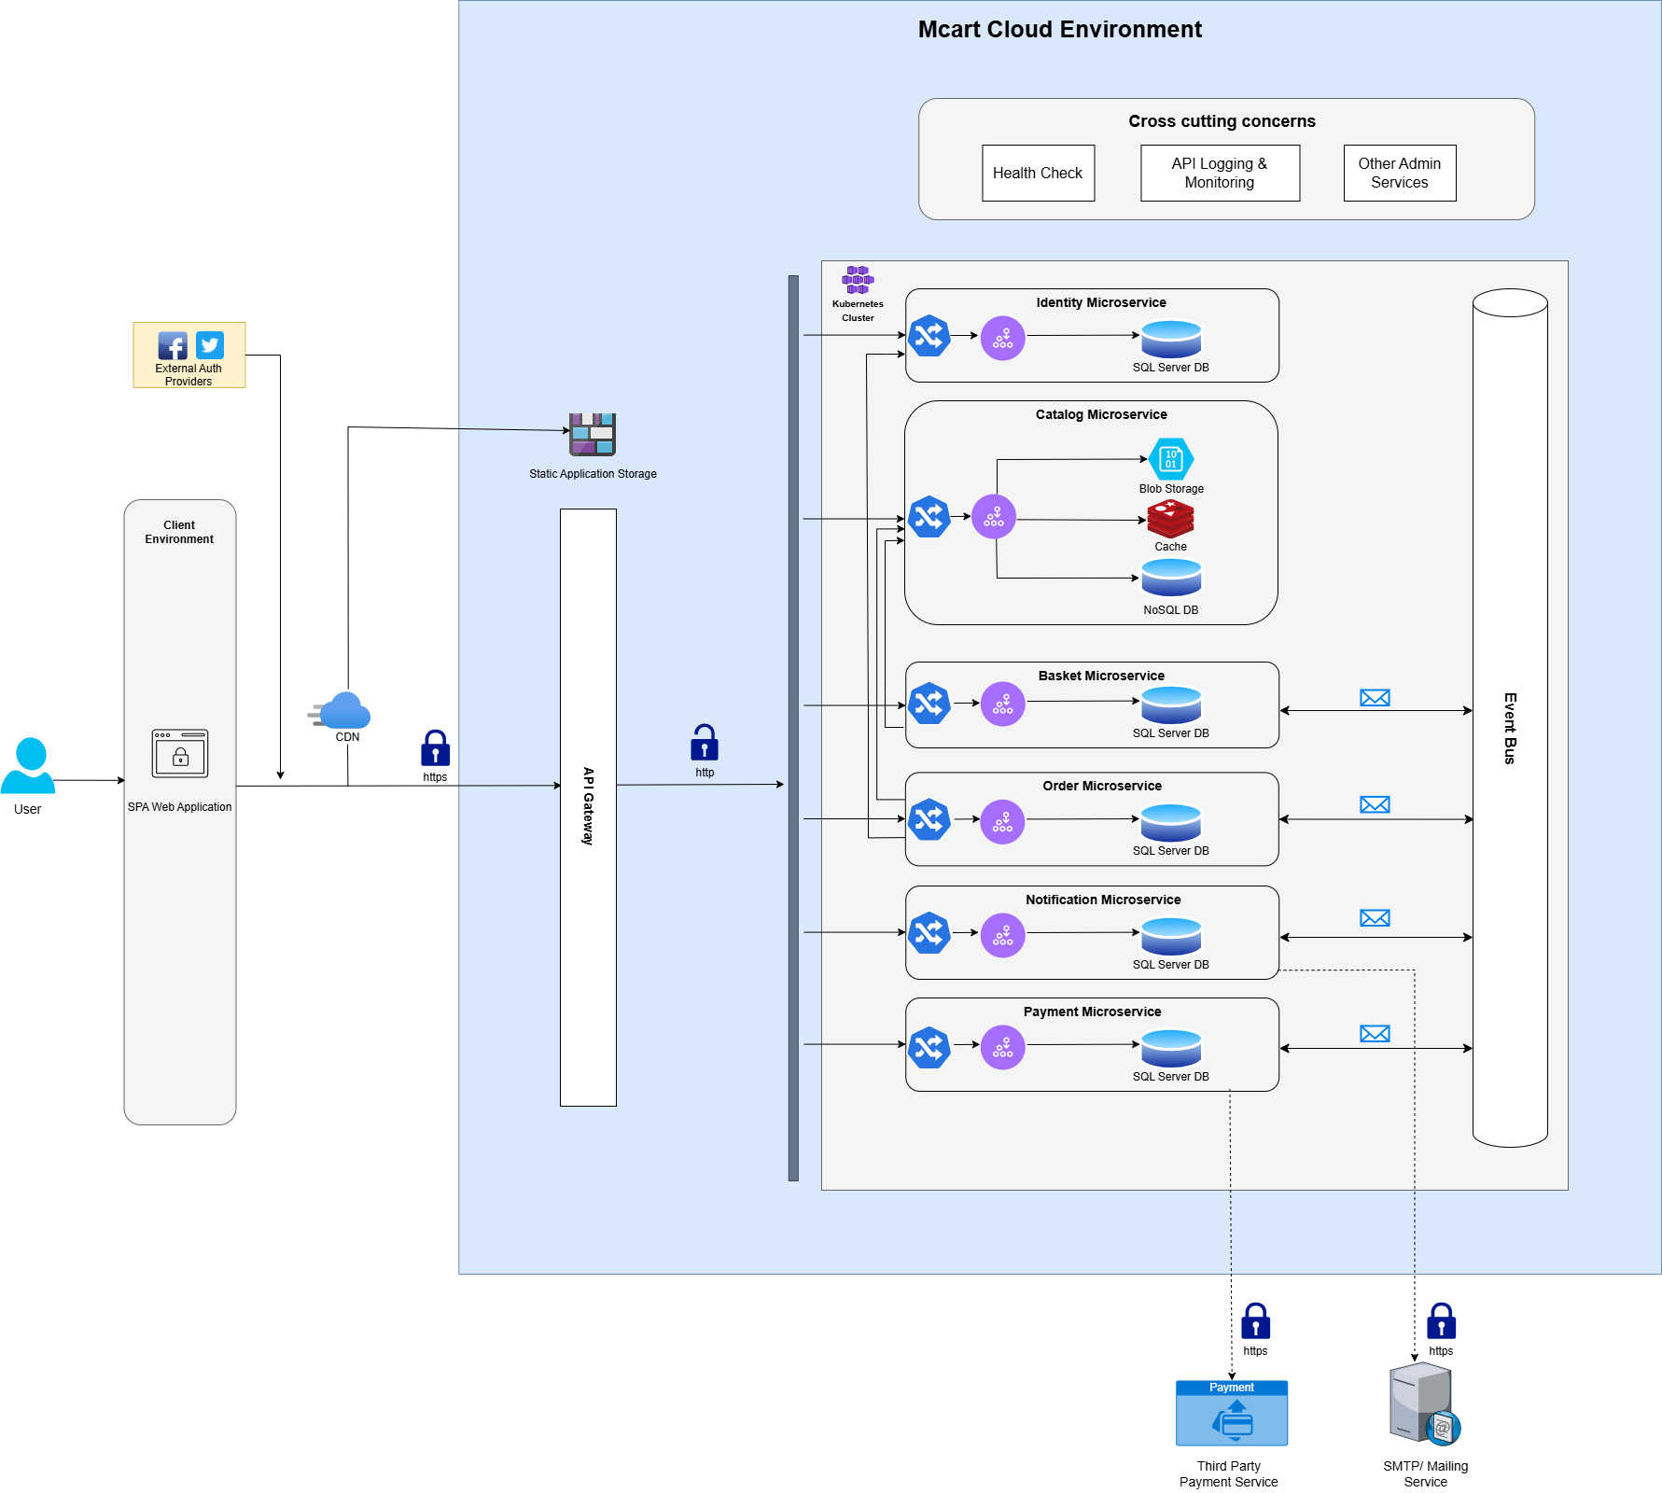
Architecture Design
Proposed architecture : SPA Frontend consuming Microservices API based on Domain Driven Design & using different types of Databases
Microservice Communication Patterns : Synchronous based on HTTP & Asynchronous based on Publish/ Subscribe model
Key Design Patterns :
API Gateway
SAGA
Circuit Breaker

Slide 7
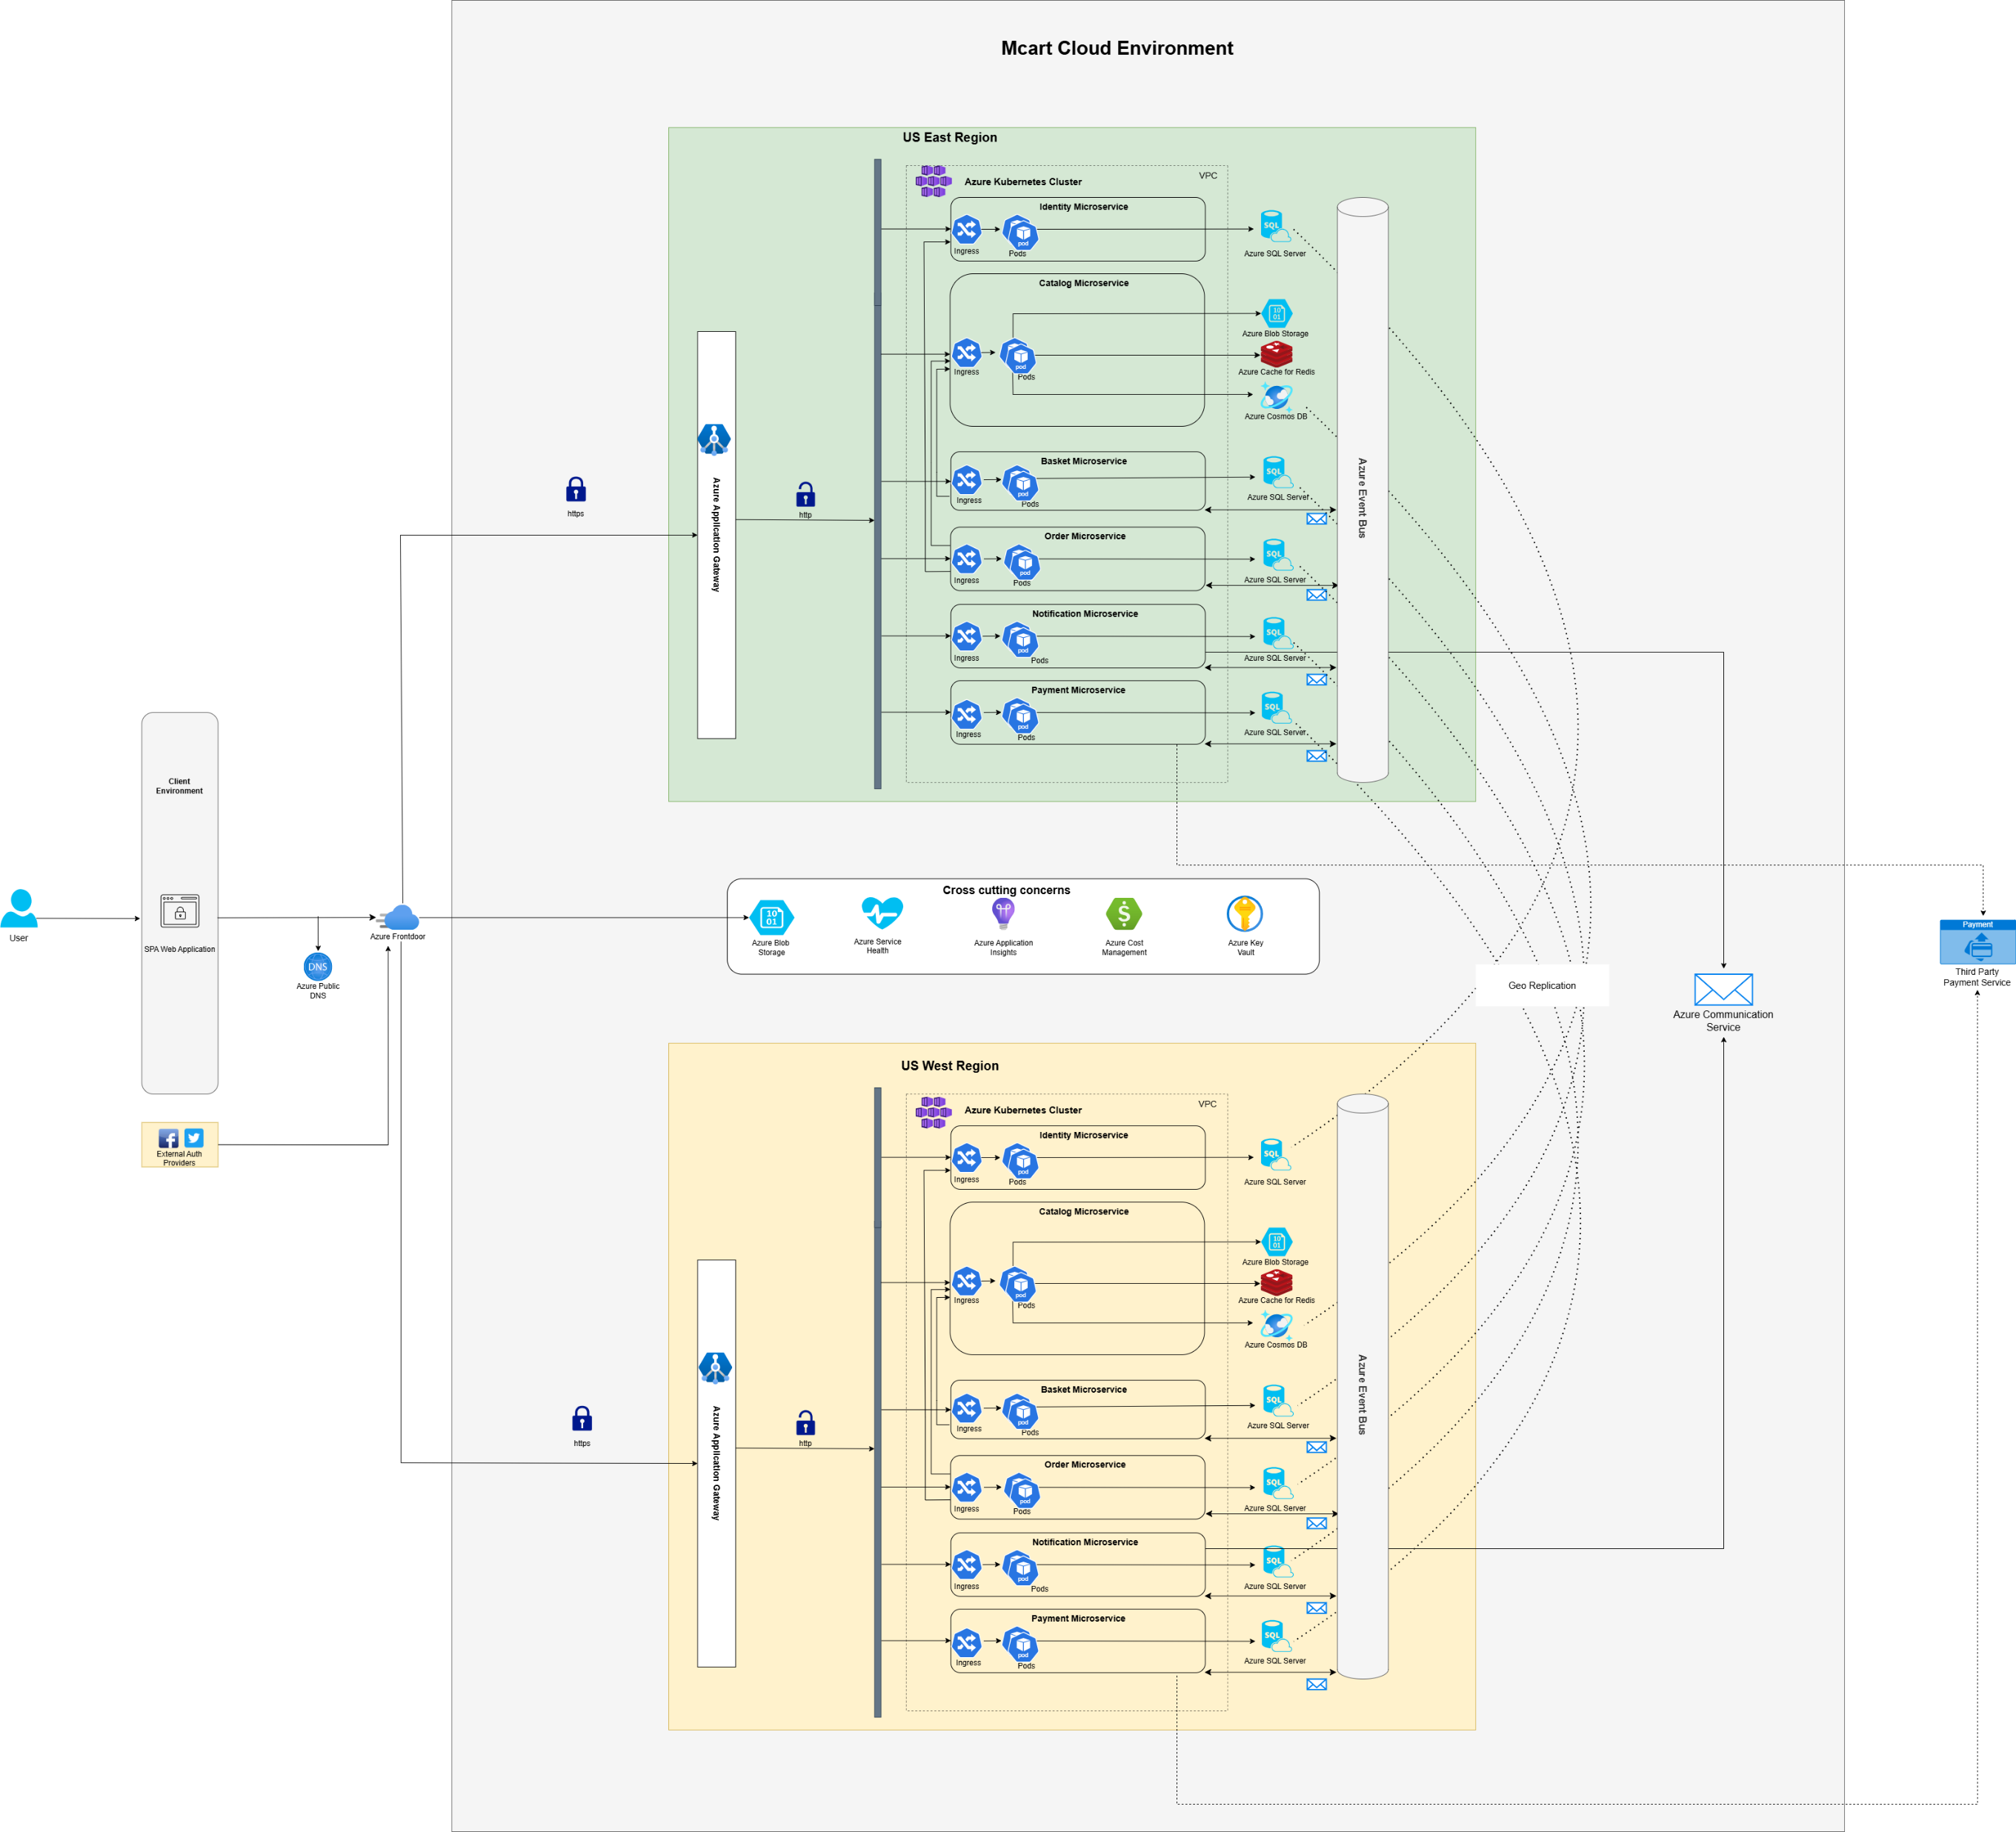
Deployment Design
Cloud Service Provider : Azure
Frontend will be hosted on Storage Account and will be served via Azure Frontdoor.
Microservices will be hosted on AKS Pods and will be behind API Gateway.
Design supports Geo-replication of Data and a standby region.

Slide 8
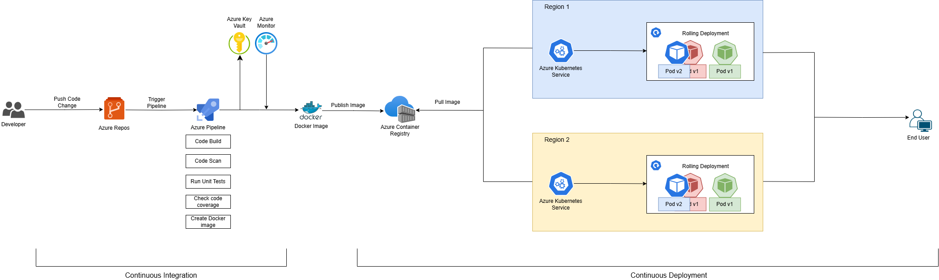
CI/ CD Design
Code will be deployed by creating a Docker Image.
Deployment strategy of Rolling Deployment is used to ensure minimum downtime.
Code will be continuously integrated and deployed on AKS-Pods.

Slide 9

Demo

